Slide 1
XYZ Portal

Slide 2
Portal Login
Register a fresh Complaint
Department login only
Please enter complaint number to check the current status

Slide 3
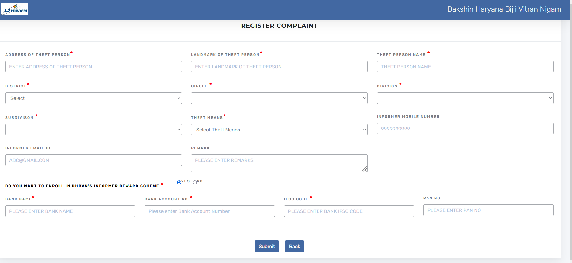
Register Complaint
1> Please fill the details . All asterisk(*) mark fields are mandatory to fill.
2> Please select ‘Yes’ if you want to claim for reward else select ‘No’
3> Bank details are required if click on ‘Yes’

Slide 4
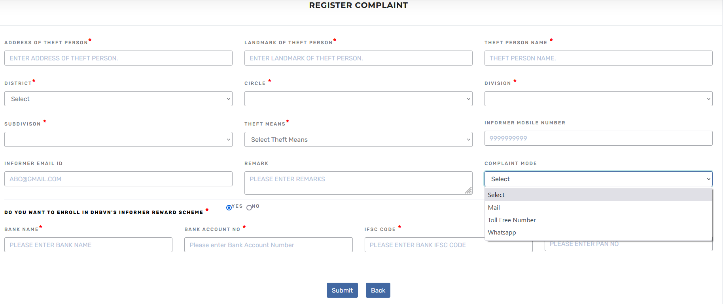
Complaint Registered By Head Office
1> Please fill the details . All asterisk(*) mark fields are mandatory to fill.
2> Please select ‘Yes’ if you want to claim for reward else select ‘No’
4> Please select Complaint Mode
3> Bank details are required if click on ‘Yes’

Slide 5
Track Complaint
Please enter complaint number to check the current status

Slide 6
Status Of Complaint

Slide 7
Subdivision Login Dashboard

Slide 8
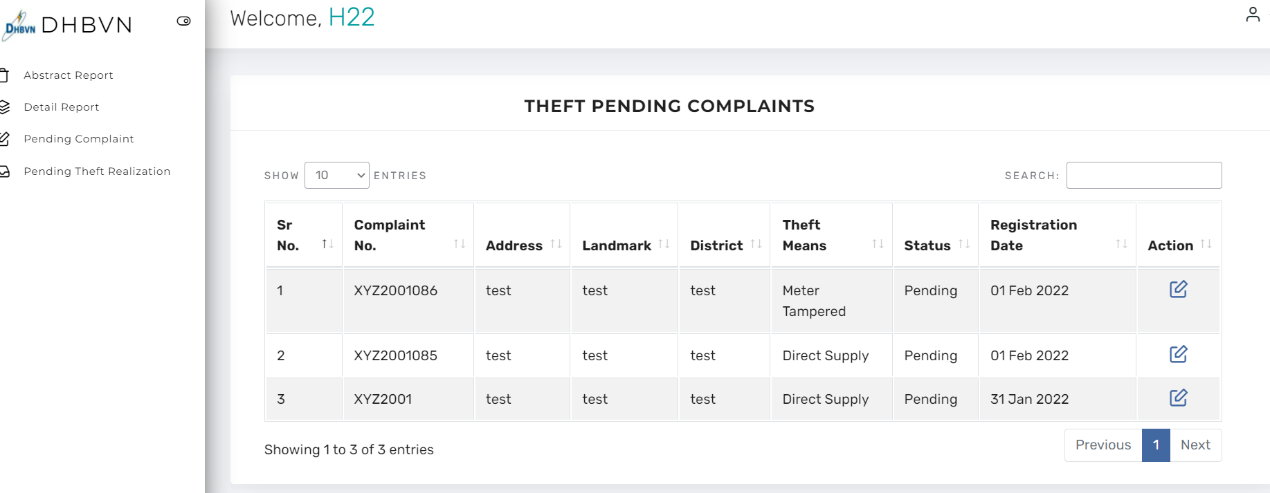
Pending Complaints for Checking
Note: Pending Complaint for checking & Pending Theft Complaints for Realization will appear only on Sub division Dashboard
1> Click on Pending Complaint
2> All theft pending complaints will appear here
3> Click on action button to fill theft details

Slide 9
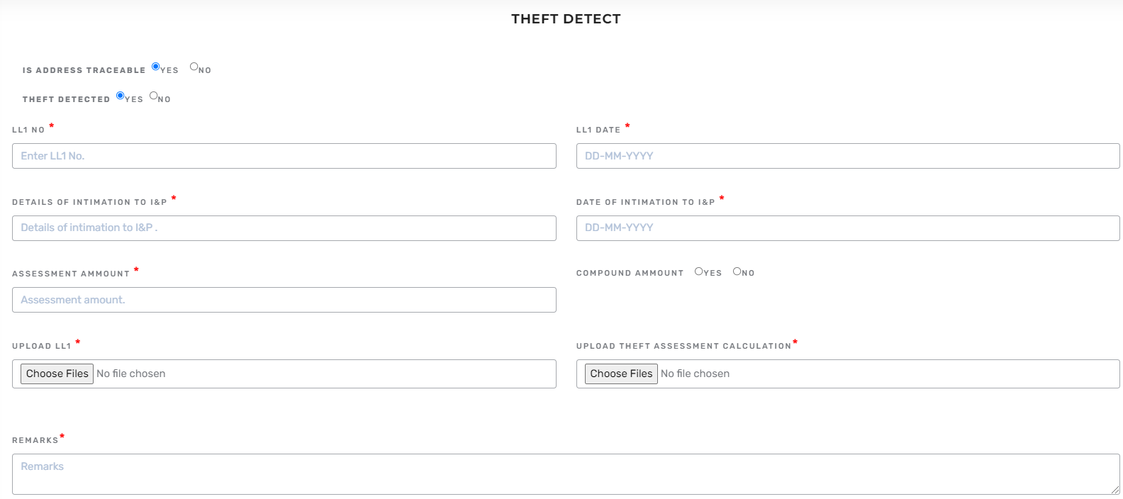
ATR Report on Complaint Received
1> Address traceable. select ‘Yes’ to continue. Select “No” in case address is not traceable
2> Theft detected,
select ‘Yes’ to fill in all the details.
3> Select ‘Yes’ to enter compounding details
4> Upload LL1
5> Upload Theft Assessment Calculation

Slide 10
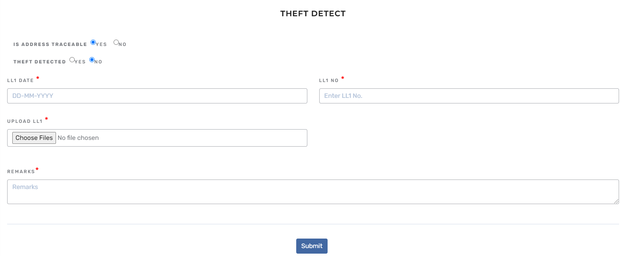
In case, No Theft is Detected on the Premises
1> If address traceable then select ‘Yes’
2> If Theft is not detected then select ‘No’
3> Please fill all details

Slide 11
In Case Address Not Traceable
1> If address is not traceable
2>In case address is incomplete, you may transfer the complaints to Circle office
3> Click on Transfer button

Slide 12
Pending Theft Realization
Note: Pending Complaint for checking & Pending Theft Complaints for Realization will appear only on Sub division Dashboard
1> Click on Pending Theft Realization
2> All pending theft realization will appear.
3> Click on action button to fill realization details

Slide 13
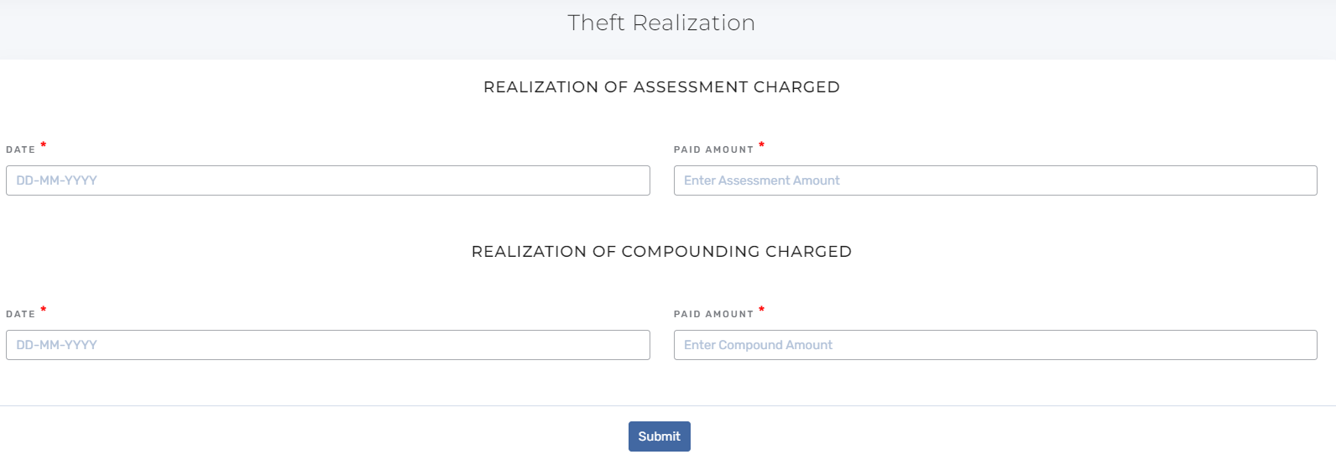
Theft Realization Details
1> Fill Realization Of Assessment Charged Date and Paid Amount
2> Fill Realization Of Compounding Charged Date and Paid Amount

Slide 14
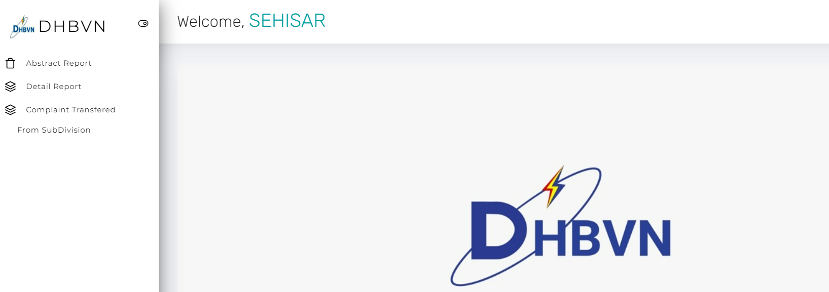
SE Circle Login Dashboard
In case, address is not traceable, complaint will be send to circle office

Slide 15
Pending Transferred Complaints

Slide 16
Transfer Complaint To Head Office

Slide 17
Transfer Complaint To Operation

Slide 18
SE Commercial Login Dashboard

Slide 19
Pending Transferred Complaints
Click on action button to take action on transferred complaints

Slide 20
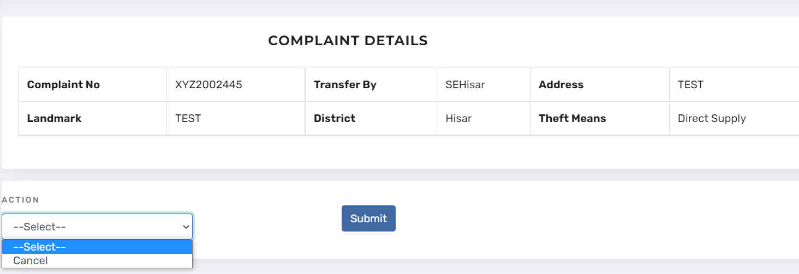
Take Action on Complaint
Please select Cancel from list and submit it. Complaint will be cancelled.

Slide 21
Chief Login Dashboard
Click on Approval for approve complaints

Slide 22
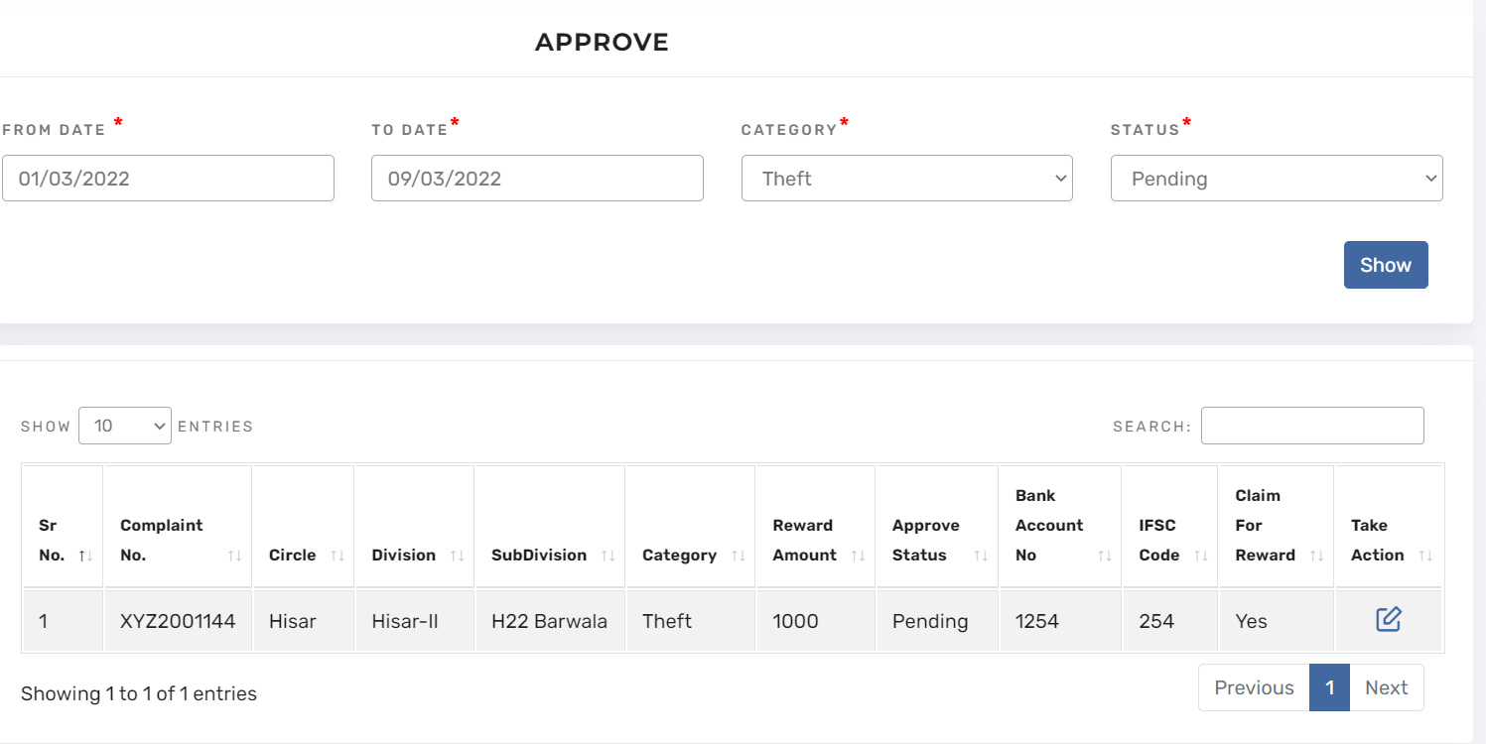
Approve Complaints For Reward
Click on action button to take action on complaints

Slide 23
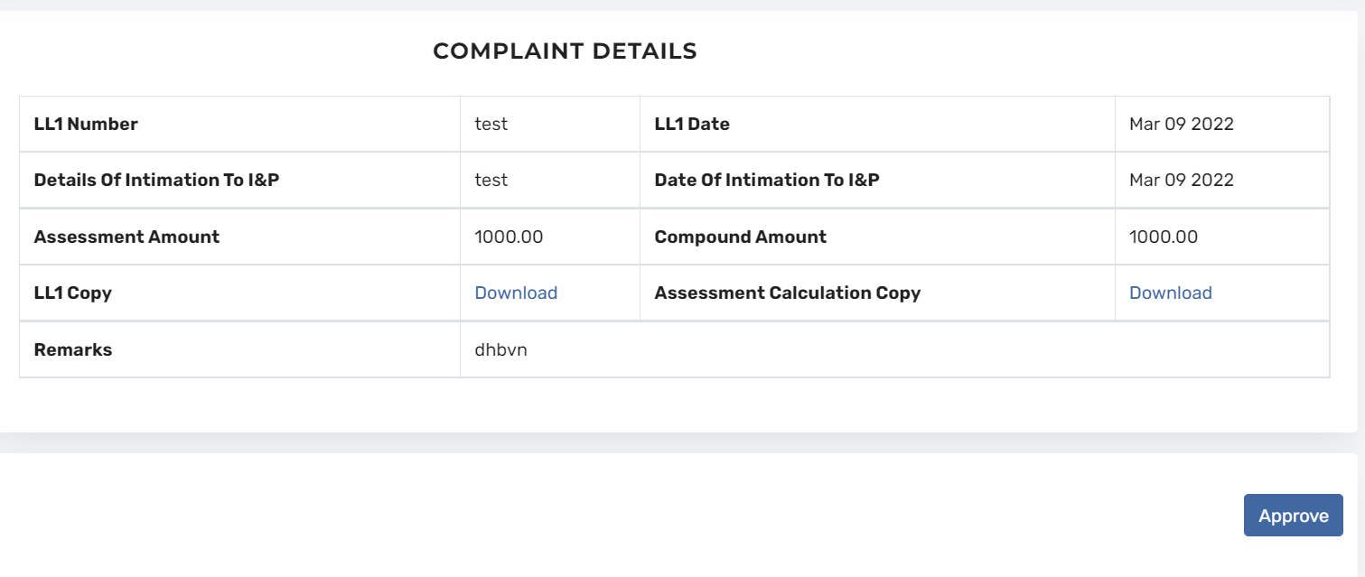
Approve Complaints For Reward
Click on Approve button to approve for reward

Slide 24
Finance Wing Login Dashboard
Click on Reward for rewarding complaints

Slide 25
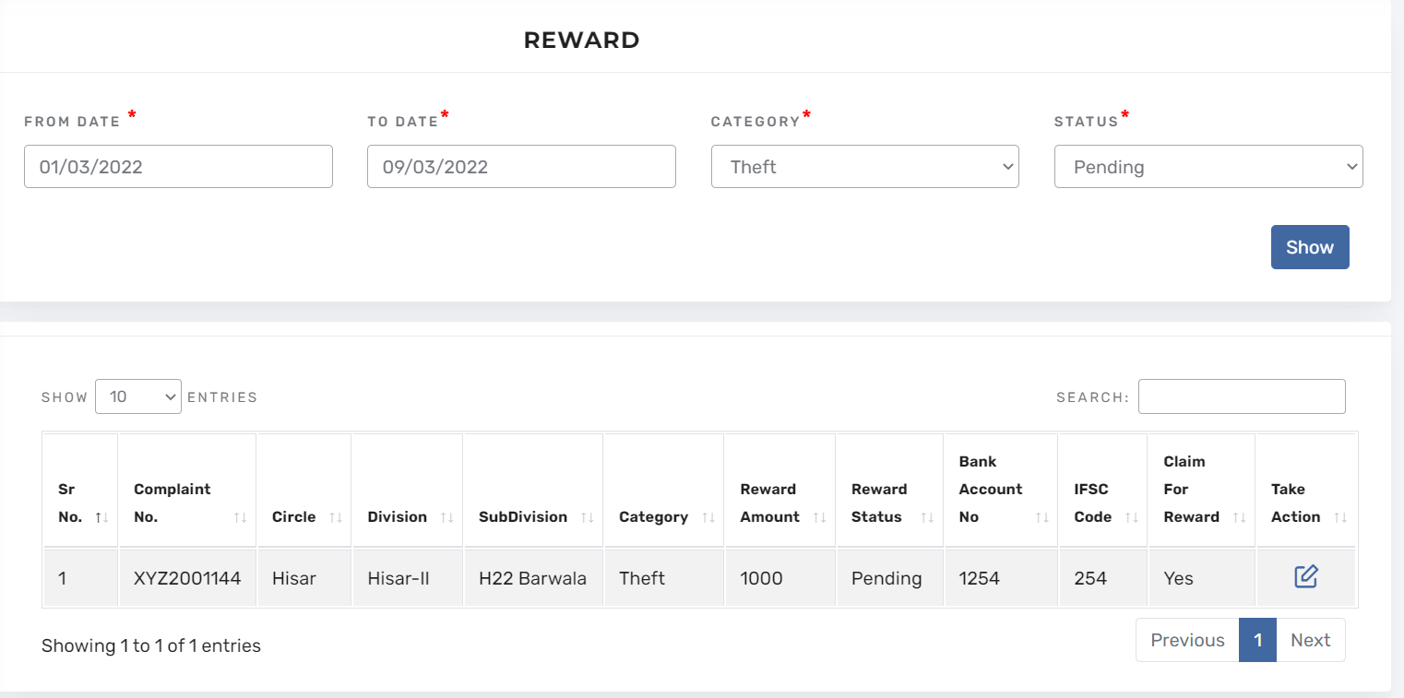
Pending Complaint For Reward
Note: after approval of chief , complaint will appear here for reward
Click on action button to take action on complaints

Slide 26
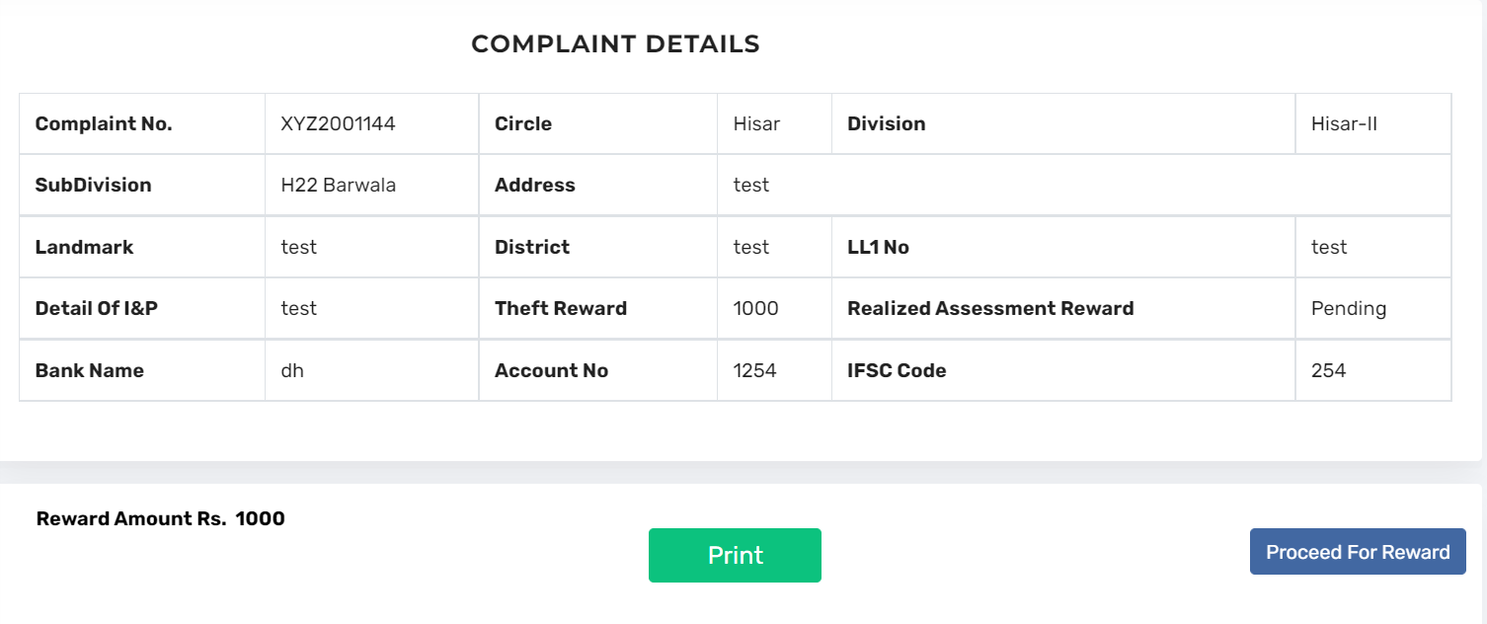
Print The Challan And Proceed for Reward

Slide 27
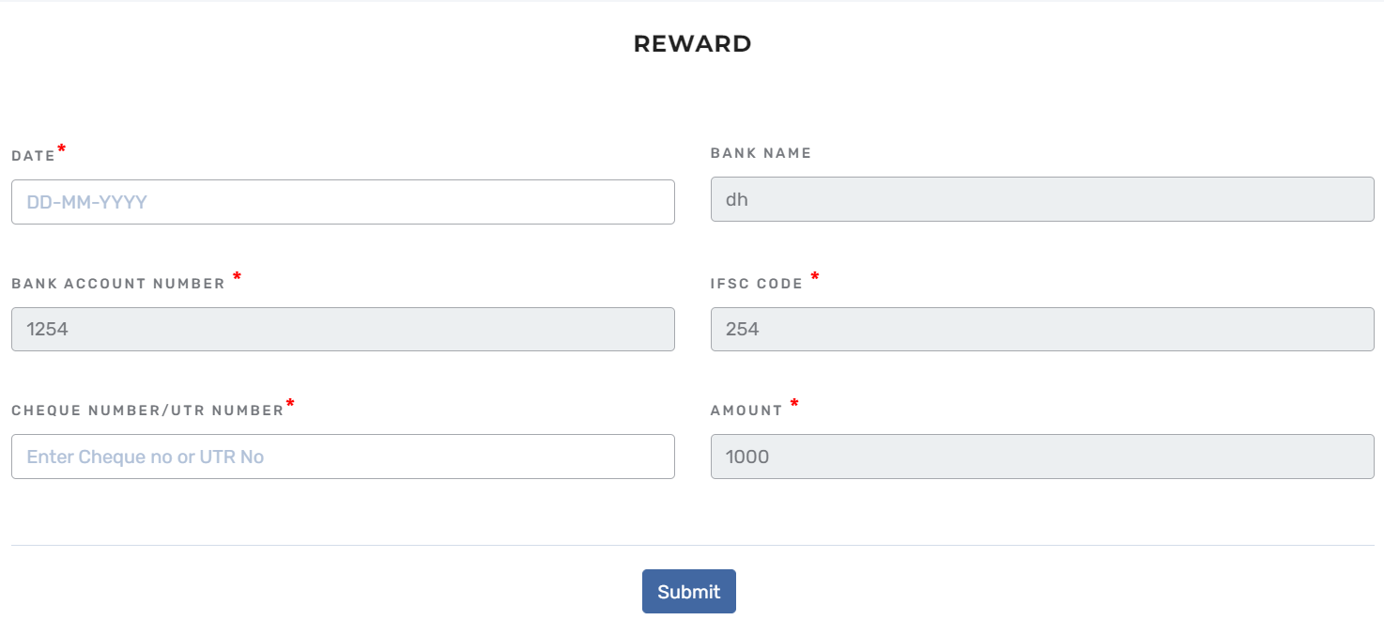
Fill Cheque No And Date

Slide 28
Detailed Report
1> Download detail report in between date
2> Please select type

Slide 29
Abstract Report

